Slide 1



ANALYSIS OF BRAND'S ONLINE REPUTATION
GROUP 4
Research Methodology | Project work
NMIMS University

Slide 2
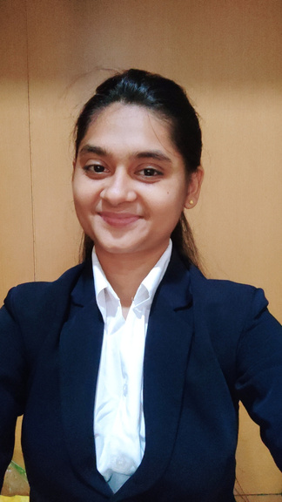


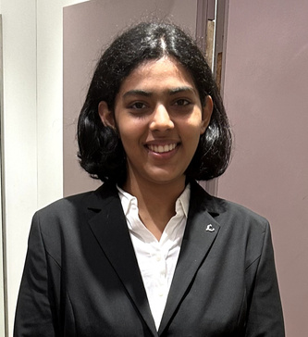

Roshni Panda
Atharva Kulkarni
Jinav Gala
THE TEAM
Nidhi Dahiya
Purvesh Khalatkar

Slide 3
RESEARCH PROBLEM
In today's digital era, a brand's reputation can be made or broken through online conversations, reviews, and social media interactions.
Hence, the research we wish to undertake is "Analysis of brand's online reputation using NLP techniques."
Page 3

Slide 4
WHY?
In the current era, online presence of brands and companies has become a necessity. Analysing the sentiment value of the brand reputation online thus becomes essential.
Why is it impactful:
Knowing the consumer perception
Detection of PR crisis
Decision making (aligned with consumer sentiments)
Page 4

Slide 5

RESEARCH TYPES
APPLIED RESEARCH
QUANTITATIVE RESEARCH
Focus on solving real world problems
Application of theoretical knowledge to practical situations
Seeks to develop insights and tools directly applicable to businesses
In this research, NLP techniques will be used to analyze and process large volume of unstructured data
Aims to quantify sentiments, identify trends and extract insights
Page 5

Slide 6
RESEARCH TYPES
ANALYTICAL RESEARCH
Gathering data from various data sources
Apply NLP techniques to analyze the sentiments of the online content about a particular brand (positive, negative or neutral)
Page 6

Slide 7
RESEARCH REVIEW
Assignment 2
Research Methodology | Project Work
NMIMS University

Slide 8
ROSHNI PANDA
OBIM: A COMPUTATIONAL MODEL TO ESTIMATE BRAND IMAGE FROM ONLINE CONSUMER REVIEW
Focus: Introduces a model for quantifying Online Brand Image (OBIM) based on consumer reviews.
Key Outcomes: Generate a score that combines positive sentiments and commonly used words. Tested using actual Amazon mobile phone reviews.
Applicability: The model helps companies figure out what people think about their brand from online reviews. It looks at how much people like the brand, how strong their feelings are, and what makes the brand special.
Mitra, S., & Jenamani, M. (2020). OBIM: A computational model to estimate brand image from online consumer review. Journal of Business Research, 114, 213-226.

Slide 9
ROSHNI PANDA
CONT...
Research Gap:
The research lacks a clear way to measure how people feel about a brand using online reviews.
Also, not many studies explain how companies can use this measurement to make good marketing choices.
Mitra, S., & Jenamani, M. (2020). OBIM: A computational model to estimate brand image from online consumer review. Journal of Business Research, 114, 213-226.

Slide 10
ATHARVA KULKARNI
MULTIFACTOR ANALYSIS OF ONLINE REPUTATION OF SELECTED CAR BRANDS
Focus: Analyzes the online reputation of various car brands using multiple factors such as reviews, media coverage, and social media activity.
Key Outcomes: Positive consumer reviews, effective social media & a strong brand identity were vital for a good online reputation. Luxury & innovative electric vehicle brands generally had a more robust online reputation.
Applicability: Use this information to improve their online reputation and marketing strategies. Serves as a valuable reference for other industries.
Dorčák, P., Markovič, P., & Pollák, F. (2017). Multifactor analysis of online reputation of selected car brands. Procedia engineering, 192, 719-724.

Slide 11
ATHARVA KULKARNI
CONT...
Research Gap:
Mentions that the study calculates scores and percentages for different reputation determinants but does not mention any statistical analysis or significance testing
Lack of rigorous statistical analysis to support the findings and conclusions of the study.
Dorčák, P., Markovič, P., & Pollák, F. (2017). Multifactor analysis of online reputation of selected car brands. Procedia engineering, 192, 719-724.

Slide 12
JINAV GALA
A BERT-BASED DEEP LEARNING APPROACH FOR REPUTATION ANALYSIS IN SOCIAL MEDIA
Focus: Centers on utilizing a BERT-based deep learning approach for social media reputation analysis
Key Outcomes: The proposed approach leverages the BERT language model for classifying text based on reputation polarity. Experimental results showcase significant improvements: a 5.8% enhancement in accuracy
Applicability: The approach introduced in the paper can be applied to analyze reputation in social media.
Rahman, M. W. U., Shao, S., Satam, P., Hariri, S., Padilla, C., Taylor, Z., & Nevarez, C. (2022, December). A BERT-based Deep Learning Approach for Reputation Analysis in Social Media. In 2022 IEEE/ACS 19th International Conference on Computer Systems and Applications (AICCSA) (pp. 1-8). IEEE.

Slide 13
JINAV GALA
CONT...
Research Gap:
Absence of comprehensive comparative studies that assess the effectiveness of BERT against other existing methods for reputation analysis in social media, highlighting the need for a rigorous evaluation of BERT's advantages and drawbacks in this specific domain.
Rahman, M. W. U., Shao, S., Satam, P., Hariri, S., Padilla, C., Taylor, Z., & Nevarez, C. (2022, December). A BERT-based Deep Learning Approach for Reputation Analysis in Social Media. In 2022 IEEE/ACS 19th International Conference on Computer Systems and Applications (AICCSA) (pp. 1-8). IEEE.

Slide 14
NIDHI DAHIYA
MINING MULTI-BRAND CHARACTERISTICS FROM ONLINE REVIEWS FOR COMPETITIVE ANALYSIS
Focus: Utilizing online reviews to understand customer opinions on products/services.
Key Outcomes: Offers insights into competitive brand strengths and weaknesses. Guides brand managers and marketers with valuable insights.
Applicability: Beneficial for decision-making in brand management and marketing. Can enhance brand competitiveness.
Guo, Y., Wang, F., Xing, C., & Lu, X. (2022). Mining multi-brand characteristics from online reviews for competitive analysis: A brand joint model using latent Dirichlet allocation. Electronic Commerce Research and Applications, 53, 101141.

Slide 15
NIDHI DAHIYA
CONT...
Research Gap:
Proposed research focuses on mining multi-brand characteristics from online reviews for competitive analysis, there are several areas where the research may lack depth or exploration. Some potential research gaps include: Aspect-Based Sentiment Analysis, Comparative Analysis Methods and Ethical Consideration
Guo, Y., Wang, F., Xing, C., & Lu, X. (2022). Mining multi-brand characteristics from online reviews for competitive analysis: A brand joint model using latent Dirichlet allocation. Electronic Commerce Research and Applications, 53, 101141.

Slide 16
PURVESH KHALATKAR
FOOD INSUFFICIENCY AND TWITTER EMOTIONS DURING A PANDEMIC
Focus: This study focuses on using real-time tweets to help food providers target urgent food needs during the pandemic
Key outcomes: The study found that specific emotions in tweets are linked to food insufficiency rates. It suggests a new way to measure well-being.
Applicability: This study can be applied to help policymakers and groups that provide food assistance. By studying people's feelings in real-time tweets, we can find out where there might be a lack of food.
Goetz, S. J., Heaton, C., Imran, M., Pan, Y., Tian, Z., Schmidt, C., ... & Mitra, P. (2023). Food insufficiency and Twitter emotions during a pandemic. Applied Economic Perspectives and Policy, 45(2), 1189-1210

Slide 17
PURVESH KHALATKAR
CONT...
Research Gap:
Comparison with Other Platforms: The paper primarily focuses on sentiment and text analysis of Twitter data. Could explore patterns and sentiment distributions on other social media platforms like FB, YT.
Machine Learning Approaches: While the paper uses the VADER approach, considering other advanced machine learning techniques for sentiment analysis can be done
Goetz, S. J., Heaton, C., Imran, M., Pan, Y., Tian, Z., Schmidt, C., ... & Mitra, P. (2023). Food insufficiency and Twitter emotions during a pandemic. Applied Economic Perspectives and Policy, 45(2), 1189-1210

Slide 18
HYPOTHESES
Assignment 3
Research Methodology | Project Work
NMIMS University

Slide 19

HYPOTHESIS 1
IMPACT OF SENTIMENT ON ONLINE BRAND REPUTATION
NULL HYPOTHESIS
(H0)
The sentiment of online customer reviews is no different from the reputation of the brand.
ALTERNATIVE HYPOTHESIS
(HA)
The sentiment of online customer reviews is different from the reputation of the brand.
Page 19

Slide 20

HYPOTHESIS 1
IMPACT OF SENTIMENT ON ONLINE BRAND REPUTATION
DATA SOURCES
Data Scraping from e-commerce websites like Amazon or google reviews
TEST THAT CAN BE USED
Either finding the corelation coefficient or using the independent samples t-test
Page 20

Slide 21
HYPOTHESIS 2
RELATIONSHIP BETWEEN BRAND PERCEPTION AND STOCK PRICE
NULL HYPOTHESIS
(H0)
There is no correlation between how the brand is perceived online and its stock price.
ALTERNATIVE HYPOTHESIS
(HA)
A correlation exists between how the brand is perceived online and its stock price.
Page 21

Slide 22
HYPOTHESIS 2
RELATIONSHIP BETWEEN BRAND PERCEPTION AND STOCK PRICE
DATA SOURCES
Data Scraping from various social media platforms and yahoo stock dataset for stock prices
TEST THAT CAN BE USED
Either finding the Pearson correlation coefficient or using the independent samples t-test
Also can do Regression Analysis
Page 22

Slide 23
HYPOTHESIS 3
BRAND IMAGE VARIATION AMONG COMPETITORS
NULL HYPOTHESIS
(H0)
There are no differences in the brand image among multiple companies within the same industry.
ALTERNATIVE HYPOTHESIS
(HA)
There are significant differences in the brand image among multiple companies within the same industry.
Page 23

Slide 24
HYPOTHESIS 3
BRAND IMAGE VARIATION AMONG COMPETITORS
DATA SOURCES
Data Scraping from various social media platforms and using specific APIs like Twitter API and YouTube API
TEST THAT CAN BE USED
ANOVA (Analysis of Variance) test
Page 24

Slide 25
HYPOTHESIS 4
EFFECT OF COVID ON BRAND REPUTATION
NULL HYPOTHESIS
(H0)
The brand reputation remains unaffected by the presence of COVID.
ALTERNATIVE HYPOTHESIS
(HA)
The brand reputation undergoes changes as a result of the influence of COVID.
Page 25

Slide 26
HYPOTHESIS 4
EFFECT OF COVID ON BRAND REPUTATION
DATA SOURCES
Data extraction by using Twitter API
TEST THAT CAN BE USED
Paired sample t-test for the comparison of means
Even chi-square test of independence if we consider the categories
Page 26

Slide 27
HYPOTHESIS 5
MARKETING CAMPAIGN METRIC
NULL HYPOTHESIS
(H0)
The specific marketing campaign did not have an impact on brand reputation.
ALTERNATIVE HYPOTHESIS
(HA)
The specific marketing campaign had an effect on brand reputation.
Page 27

Slide 28
HYPOTHESIS 5
MARKETING CAMPAIGN METRIC
DATA SOURCES
Data extraction by using Twitter API or YouTube API. Also by scraping news websites
TEST THAT CAN BE USED
Paired sample t-test for the comparison of means
Or can use chi-square test of independence if we keep the categories (positive, negative and neutral)
Page 28

Slide 29
RESEARCH DESIGN
Assignment 4
Research Methodology | Project Work
NMIMS University

Slide 30
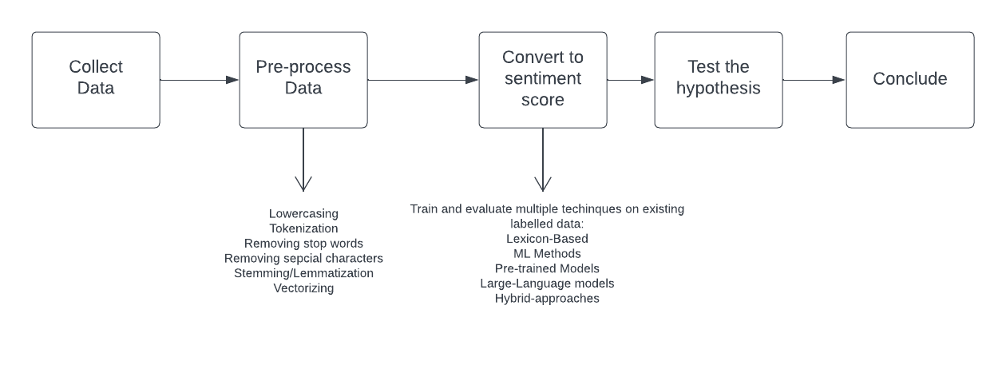
OVERALL STATISTICAL DESIGN
Page 30

Slide 31
IMPACT OF ONLINE BRAND SENTIMENTS
ON ACTUAL REPUTATION (HYPO - 1)
Design | Design
Sampling Design | Brand selected: McDonald’s Reviews sampled from major Mumbai outlets’ online info-card
Observational Design | Collect reviews data using web scraping tools. Use Google Forms to conduct a survey (Questionnaire covered in the next section)
Statistical Design | Analyse sentiment-reputation relationship using correlation analysis and using the independent samples t-test.
Operational Design | Employ Python for data collection and analysis, implement data preprocessing for quality control, and visualize findings using charts and graphs.
Page 31

Slide 32
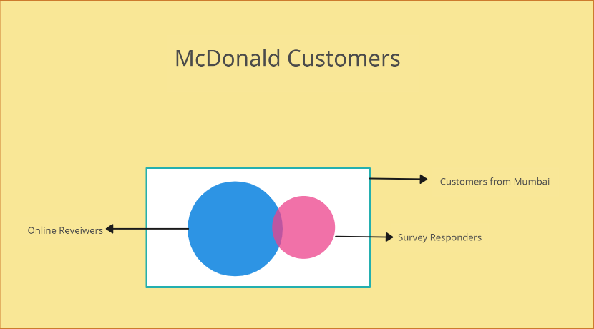
IMPACT OF ONLINE BRAND SENTIMENTS
ON ACTUAL REPUTATION (HYPO - 1)
SAMPLING OVERVIEW
Page 32

Slide 33
RELATIONSHIP BETWEEN BRAND PERCEPTION AND STOCK PRICE (HYPO - 2)
Design | Design
Sampling Design | Brand selected: Coca Cola Company Data collected for period: 1st August 2022 - 1st August 2023
Observational Design | Analyze sentiment data from social media platforms (e.g., Twitter) and stock price movements from yahoo stock price api
Statistical Design | Use regression analysis to assess the relationship between brand perception (sentiment scores) and stock price changes, controlling for relevant factors.
Operational Design | Employ Python and financial APIs for data collection and analysis, preprocess data for consistency, and visualize results through daily stock price charts.
Page 33

Slide 34
BRAND IMAGE VARIATION AMONG COMPETITORS (HYPO - 3)
Design | Design
Sampling Design | Brands selected: Xiaomi, Samsung, Oppo Latest 10 models will be considered considering all the series under the brand
Observational Design | Scraping the data from Amazon and Flipkart Market places
Statistical Design | Utilize ANOVA or t-tests to compare mean brand image scores among competitors, identifying significant variations.
Operational Design | Use online survey tools for data collection, and present findings through comparative charts and summary statistics.
Page 34

Slide 35
EFFECT OF COVID ON BRAND REPUTATION (HYPO - 4)
Design | Design
Sampling Design | Brand selected: IKEA One year before and after COVID is the sample we’re considering
Observational Design | Collecting tweets for IKEA by the users within the period using API and Scraping methods
Statistical Design | Use paired t-tests or non-parametric tests to compare pre-COVID and COVID-affected sentiment scores, determining the changes in brand reputation.
Operational Design | Automate data collection with web scraping tools, preprocess text data, and visualize results through before-and-after sentiment trend graphs.
Page 35

Slide 36
MARKETING CAMPAIGN METRIC (HYPO - 5)
Design | Design
Sampling Design | Brand selected: Tanishq Ekatvam Ad Campaign 2020
Observational Design | Data extraction by using Twitter API or YouTube API. Also by scraping news websites. Period: Before and After the campaign
Statistical Design | Paired sample t-test for the comparison of means or can use chi-square test of independence if we keep the categories (positive, negative, neutral).
Operational Design | Implement data collection through web analytics tools, automate report generation, and visualize results through dashboards for real-time monitoring.
Page 36

Slide 37
PILOT SURVEY QUESTIONNAIRE
Research Methodology | Project Work
NMIMS University

Slide 38
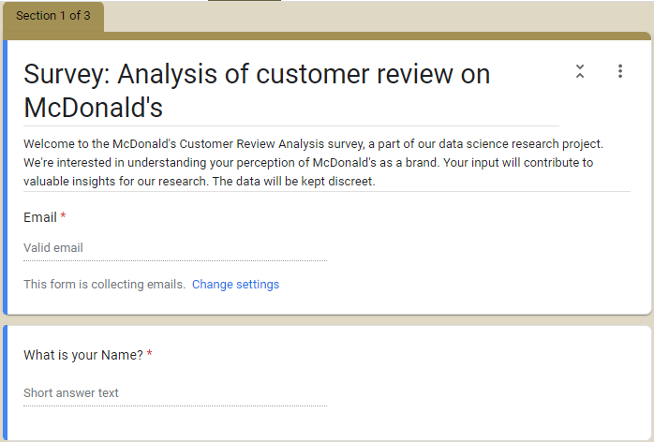
Page 38

Slide 39
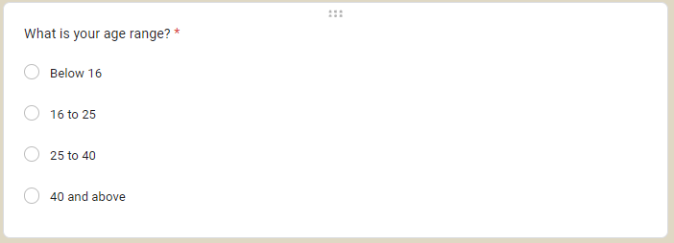
Question 2
Why? The age range question is important to ask in a brand online reputation survey because it can help to identify different customer segments and understand how they perceive the brand differently.
Page 39

Slide 40
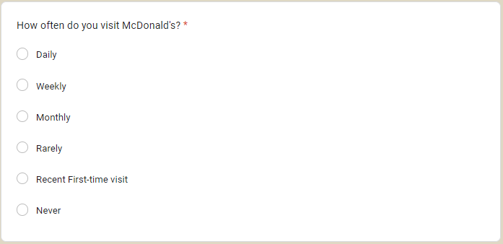
Question 3
Why ? :- Brand loyalty
This question helps to understand how often customers interact with the brand and how likely they are to return.
Page 40

Slide 41
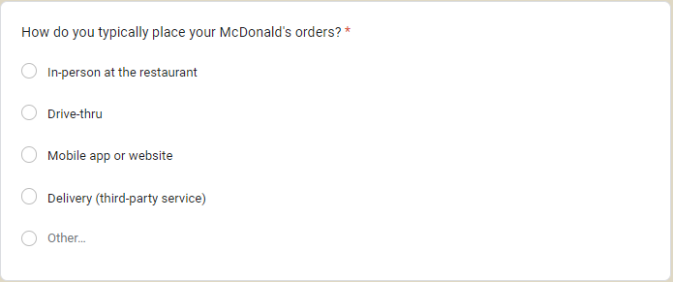
Question 4
(Only for those who don’t select never in previous question)
Why? Customer experience
These questions help to understand how customers prefer to interact with the brand and how they perceive their experience.
Page 41

Slide 42
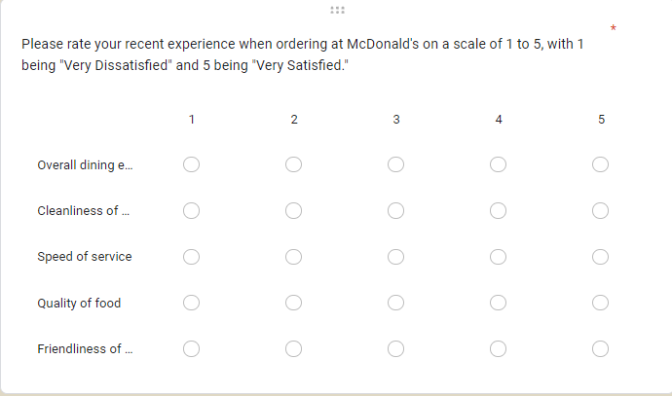
Question 5
Why? This question helps brands to understand how customers perceive their experience. For example, did customers have a long wait time? Was the food prepared to their liking? Was the staff friendly and helpful? This information can be used to identify areas where the brand can improve its customer service and food quality.
Page 42

Slide 43
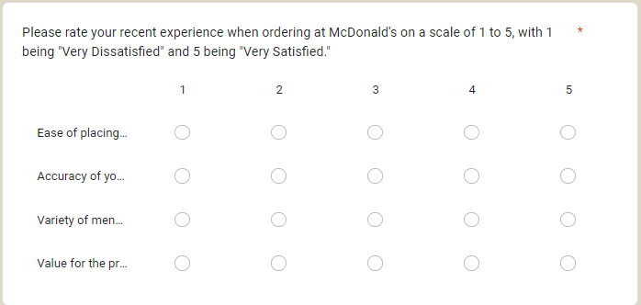
Question 6
Why? This question helps brands to understand how customers perceive their experience. For example, did customers have a long wait time? Was the food prepared to their liking? Was the staff friendly and helpful? This information can be used to identify areas where the brand can improve its customer service and food quality.
Page 43

Slide 44
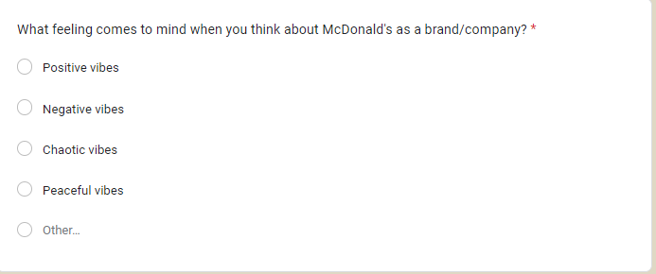
Question 7
Why? This question helps brands to understand the emotional connection that customers have with their brand. For example, do customers associate McDonald's with happiness, nostalgia, or convenience? This information can be used to develop marketing campaigns and create brand experiences that resonate with customers on an emotional level.
Page 44

Slide 45
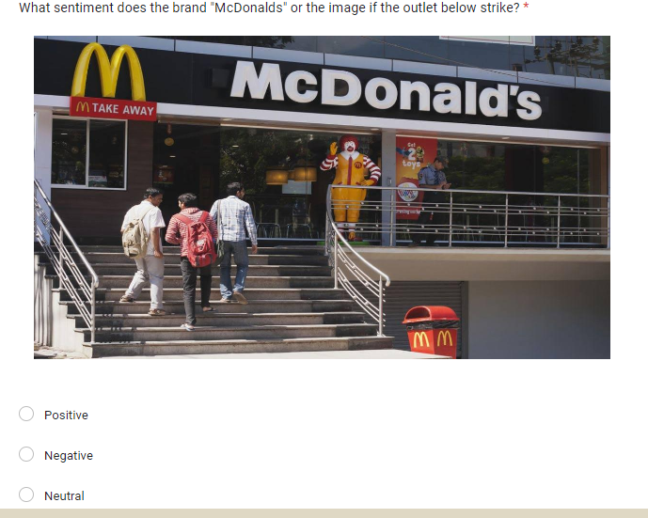
Question 8
(Only for those who select never in 3rd question)
Why ? "What sentiment does the brand 'McDonald's' or the image strike?" to get a better understanding of how people perceive the brand on an emotional level. This is important because brands that can evoke positive emotions in their customers are more likely to be successful.
Page 45

Slide 46
Data SnapShot
Link to the google sheet:
https://docs.google.com/spreadsheets/d/1usUirmo_SRbbVHjzr6DZHAfxF0fJlHqtVrfXHl65lQs/edit?usp=sharing
Page 46

Slide 47
DATA ANALYSIS
Research Methodology | Project Work
NMIMS University

Slide 48
Cronbach's alpha Analysis of the questionnaire
Cronbach's alpha: 0.8915
Strong internal consistency in McDonald's dining experience survey.
High reliability: Survey items effectively measure the same underlying aspects.
Valuable tool for assessing customer satisfaction and experiences at McDonald's.
Link to the google colab notebook:
https://colab.research.google.com/drive/1ml7_3yBYGgy3peZbmea9njw3DBafVuaz?usp=sharing
https://colab.research.google.com/drive/1ml7_3yBYGgy3peZbmea9njw3DBafVuaz?usp=sharing
Page 48

Slide 49
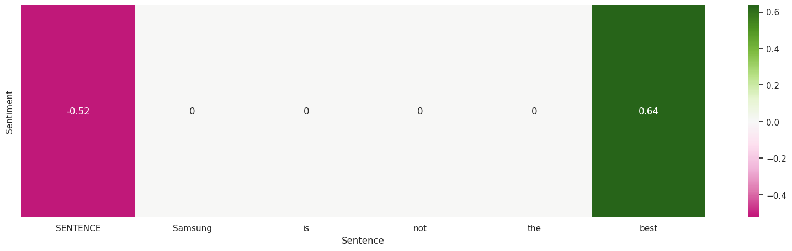
Sentiment Analysis Technique
We used Vader-Lexicon to score the sentiments.
It is a rule-based and context-based algorithm to score the polarity.
Page 49

Slide 50
HYPOTHESIS 1
IMPACT OF SENTIMENT ON ONLINE BRAND REPUTATION
Test | Paired T-test
p-value | 0.0000003
Conclusion | Google review sentiments are significantly different than the surveyed review sentiments.
Page 50

Slide 51
HYPOTHESIS 2
RELATIONSHIP BETWEEN BRAND PERCEPTION AND STOCK PRICE
Test | Regression Analysis
Correlation | 0.23
Conclusion | There is no correlation between the sentiments of tweets and stock price changes
Page 51

Slide 52
HYPOTHESIS 3
BRAND IMAGE VARIATION AMONG COMPETITORS
Test | ANOVA(Analysis of Variance)
p-value | 0.304
Conclusion | Fail to reject null hypothesis. There is no significant difference in the sentiments of mobile reviews for the given brands
Page 52

Slide 53
HYPOTHESIS 4
EFFECT OF COVID ON BRAND REPUTATION
Test | Paired T-test
p-value | 0.736
Conclusion | Failed to reject null hypothesis. There is no significant effect of sentiments in regards to IKEA of COVID-19 pandemic
Page 53

Slide 54
HYPOTHESIS 5
MARKETING CAMPAIGN METRIC
The Instagram comments were scraped of Tanishq before and after their Ekatvam campaign
The comments were short, and had no sense of interaction with the product/brand
The comments consisted of queries for cost, thus not useful for sentiment analysis
Page 54

Slide 55
CONCLUSION
Evaluating sentiments of consumers on online platforms can used for certain cases:
Where surveys don’t usually portray the true brand perception
Where you want to compare two or more brands in terms of consumer perception
However, sentiments are not found to be correlated with stock price of the company as various other factors affect the stocks too
Effects of certain events/campaigns may be assessed using the consumer sentiments
Page 55

Slide 56
RESEARCH LIMITATIONS
This study stuck to a single method of scoring sentiments
It was an overview of the topic of sentiment and it’s impact on brand.. it doesn’t delve into one particular area and dig deeper
Only one primary data source was considered
Page 56

Slide 57
FUTURE RESEARCH
Various sentiment analysis methods can be applied and evaluated
Deep learning and transformer based models can be used
Primary data collection can be implemented to enrich the research
Focus on one particular area of the hypothesis and delve deeper for better conclusions
Page 57

Slide 58
THANK YOU
Presentation by Group 4
Research Methodology Project Work | 2023
NMIMS University

